Slide 1
Chapter Nine
OBJECTS AND CLASSES
May 17, 2013

Slide 2
Chapter Goals
To understand the concepts of classes, objects and encapsulation
To implement instance variables, methods and constructors
To be able to design, implement, and test your own classes
To understand the behavior of object references
In this chapter, you will learn how to discover, specify, and implement your own classes, and how to use them in your programs.

Slide 3
Contents
Object-Oriented Programming
Implementing a Simple Class
Specifying the Public Interface of a Class
Designing the Data Representation
Constructors
Implementing Methods
Testing a Class
Problem Solving: Tracing Objects
Problem Solving: Patterns for Object data
Object References
Application: Writing a Fraction Class

Slide 4
Object-Oriented Programming
You have learned structured programming
  Breaking tasks into subtasks
  Writing re-usable methods to handle tasks
We will now study Objects and Classes
  To build larger and more complex programs
  To model objects we use in the world
A class describes objects with the same behavior.
For example, a Car class describes all passenger vehicles that have a certain capacity and shape.

Slide 5
Objects and Programs
You have learned how to structure your programs by decomposing tasks into functions
  Experience shows that it does not go far enough
  It is difficult to understand and update a program that consists of a large collection of functions
To overcome this problem, computer scientists invented object-oriented programming, a programming style in which tasks are solved by collaborating objects
Each object has its own set of data, together with a set of methods that act upon the data

Slide 6
Objects and Programs
You have already experienced this programming style when you used strings, lists, and file objects. Each of these objects has a set of methods
For example, you can use the insert() or remove() methods to operate on list objects

Slide 7
Python Classes
A class describes a set of objects with the same behavior.
  For example, the str class describes the behavior of all strings
  This class specifies how a string stores its characters, which methods can be used with strings, and how the methods are implemented.
  For example, when you have a str object, you can invoke the upper method:
"Hello, World".upper()
String object
Method of class String

Slide 8
Python Classes
  In contrast, the list class describes the behavior of objects that can be used to store a collection of values
  This class has a different set of methods
  For example, the following call would be illegal—the list class has no upper() method
["Hello", "World"].upper()
  However, list has a pop() method, and the following call is legal
["Hello", "World"].pop()

Slide 9
Public Interfaces
The set of all methods provided by a class, together with a description of their behavior, is called the public interface of the class
When you work with an object of a class, you do not know how the object stores its data, or how the methods are implemented
  You need not know how a str object organizes a character sequence, or how a list stores its elements
All you need to know is the public interface––which methods you can apply, and what these methods do

Slide 10
Public Interfaces
The process of providing a public interface, while hiding the implementation details, is called encapsulation
If you work on a program that is being developed over a long period of time, it is common for implementation details to change, usually to make objects more efficient or more capable
  When the implementation is hidden, the improvements do not affect the programmers who use the objects

Slide 11
Implementing a Simple Class
Example:
Tally Counter: A class that models a mechanical device that is used to count people
  For example, to find out how many people attend a concert or board a bus
What should it do?
  Increment the tally
  Get the current total

Slide 12
Using the Counter Class
First, we construct an object of the class (object construction will be covered shortly):
In Python, you don’t explicitly declare instance variables
  Instead, when one first assigns a value to an instance variable, the instance variable is created
tally = Counter() # Creates an instance

Slide 13
Using the Counter Class
Next, we invoke methods on our object
tally.reset()
tally.click()
tally.click()
result = tally.getValue() # Result is 2
tally.click()
result = tally.getValue() # Result is 3

Slide 14
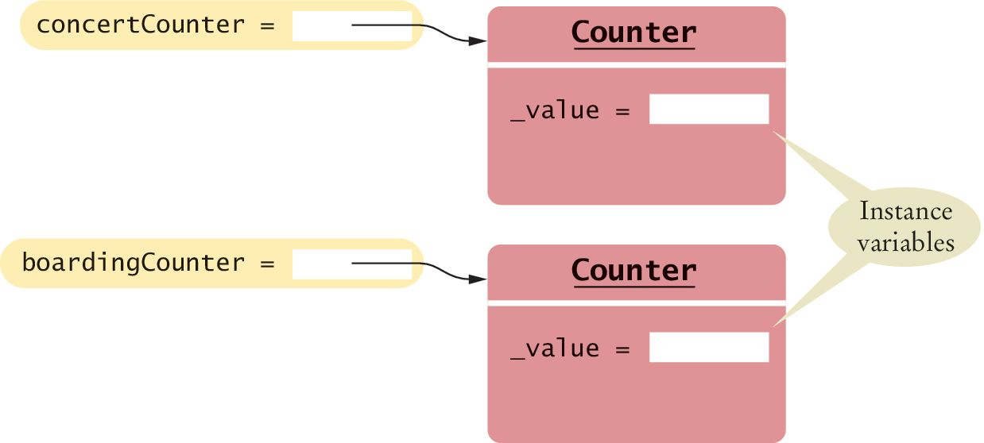
Instance Variables
An object stores its data in instance variables
An instance of a class is an object of the class
In our example, each Counter object has a single instance variable named _value
  For example, if concertCounter and boardingCounter are two objects of the Counter class, then each object has its own _value variable

Slide 15
Instance Variables
Instance variables are part of the implementation details that should be hidden from the user of the class
  With some programming languages an instance variable can only be accessed by the methods of its own class
  The Python language does not enforce this restriction
  However, the underscore indicates to class users that they should not directly access the instance variables

Slide 16
Class Methods
The methods provided by the class are defined in the class body
The click() method advances the _value instance variable by 1
def click(self) :
self._value = self._value + 1
A method definition is very similar to a function with these exceptions:
  A method is defined as part of a class definition
  The first parameter variable of a method is called self

Slide 17
Class Methods and Attributes
Note how the click() method increments the instance variable _value
Which instance variable? The one belonging to the object on which the method is invoked
  In the example below the call to click() advances the _value variable of the concertCounter object
  No argument was provided when the click() method was called even though the definition includes the self parameter variable
  The self parameter variable refers to the object on which the method was invoked concertCounter in this example
concertCounter.click()

Slide 18
Example of Encapsulation
The getValue() method returns the current _value:
def getValue(self) :
return self._value
This method is provided so that users of the Counter class can find out how many times a particular counter has been clicked
A class user should not directly access any instance variables
Restricting access to instance variables is an essential part of encapsulation

Slide 19
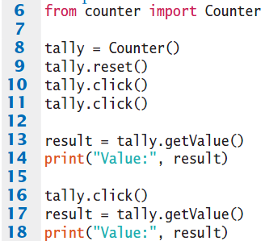
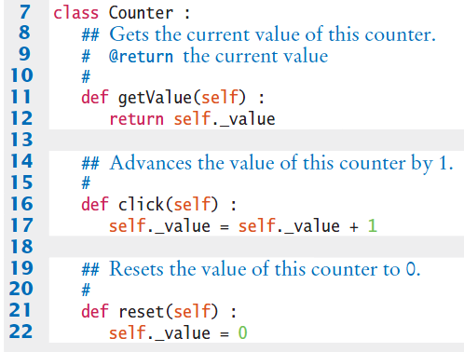

Complete Simple Class Example
Program execution

Slide 20
Public Interface of a Class
When you design a class, start by specifying the public interface of the new class
    What tasks will this class perform?
    What methods will you need?
    What parameters will the methods need to receive?

Slide 21
Example Public Interface
  Example: A Cash Register Class
Task | Method
Add the price of an item | addItem(price)
Get the total amount owed | getTotal()
Get the count of items purchased | getCount()
Clear the cash register for a new sale | clear()
    Since the ‘self’ parameter is required for all methods it was excluded for simplicity

Slide 22
Writing the Public Interface
## A simulated cash register that tracks the item count and the total amount due.
#
class CashRegister :
## Adds an item to this cash register.
# @param price: the price of this item
#
def addItem(self, price) :
# Method body
## Gets the price of all items in the current sale.
# @return the total price
#
def getTotal(self): ...
Class comments document the class and the behavior of each method
The method declarations make up the public interface of the class
The data and method bodies make up the private implementation of the class

Slide 23
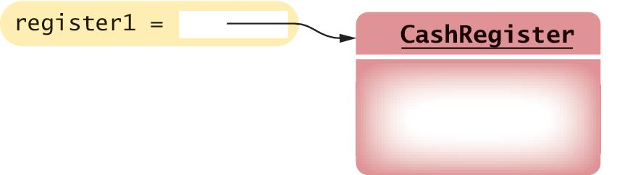
Using the Class
After defining the class we can now construct an object:
register1 = CashRegister()
# Constructs a CashRegister object
This statement defines the register1 variable and initializes it with a reference to a new CashRegister object

Slide 24
Using Methods
Now that an object has been constructed, we are ready to invoke a method:
register1.addItem(1.95) # Invokes a method.

Slide 25
Accessor and Mutator Methods
Many methods fall into two categories:
  1) Accessor Methods: 'get' methods
    Asks the object for information without changing it
    Normally returns the current value of an attribute
def getTotal(self):
def getCount(self):
  2) Mutator Methods: 'set' methods
    Changes values in the object
    Usually take a parameter that will change an instance variable
def addItem(self, price):
def clear(self):

Slide 26
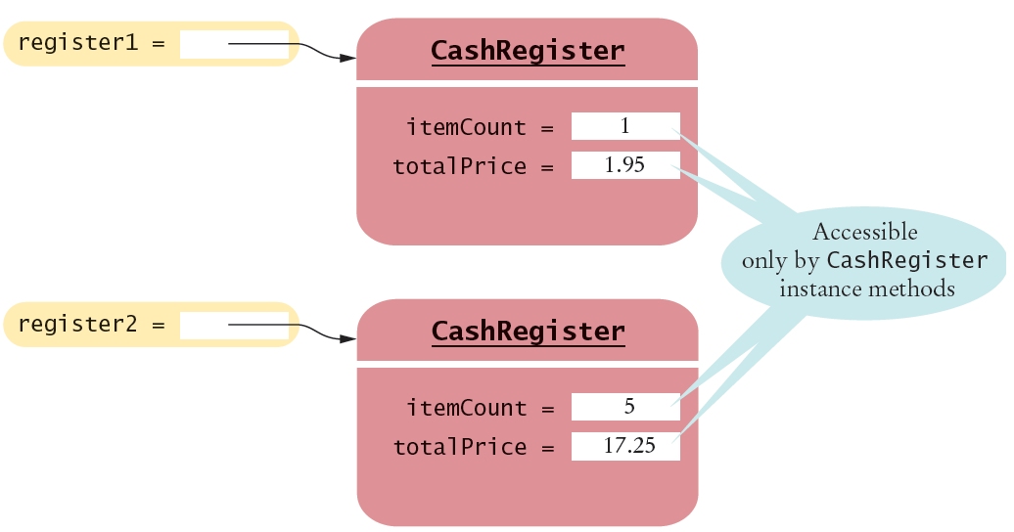
Instance Variables of Objects
Each object of a class has a separate set of instance variables
The values stored in instance variables make up the state of the object.

Slide 27
Designing the Data Representation
An object stores data in instance variables
  Variables declared inside the class
  All methods inside the class have access to them
    Can change or access them
  What data will our CashRegister methods need?
Task | Method | Data Needed
Add the price of an item | addItem(price) | total, count
Get the total amount owed | getTotal() | total
Get the count of items purchased | getCount() | count
Clear cash register for a new sale | clear() | total, count
An object holds instance variables that are accessed by methods

Slide 28
Programming Tip 9.1
All instance variables should be private and most methods should be public
  Although most object-oriented languages provide a mechanism to explicitly hide or protect private members from outside access, Python does not
It is common practice among Python programmers to use names that begin with a single underscore for private instance variables and methods
  The single underscore serves as a flag to the class user that those members are private

Slide 29
Programming Tip 9.1
You should always use encapsulation, in which all instance variables are private and are only manipulated with methods
Typically, methods are public
  However, sometimes you have a method that is used only as a helper method by other methods
  In that case, you should identify the helper method as private by using a name that begins with a single underscore

Slide 30
Constructors
A constructor is a method that initializes instance variables of an object
  It is automatically called when an object is created
# Calling a method that matches the name of the class
# invokes the constructor
register = CashRegister()
Python uses the special name _ _init_ _ for the constructor because its purpose is to initialize an instance of the class:
def _ _init_ _(self) :
self._itemCount = 0
self._totalPrice = 0

Slide 31
Default and Named Arguments
Only one constructor can be defined per class
But you can a define constructor with default argument values that simulate multiple definitions
class BankAccount :
def __init__(self, initialBalance = 0.0) :
self._balance = initialBalance
  If no value is passed to the constructor when a BankAccount object is created the default value will be used
joesAccount = BankAccount() # Balance is set to 0

Slide 32
Default and Named Arguments
  If a value is passed to the constructor that value will be used instead of the default one
joesAccount = BankAccount(499.95)
# Balance is set to 499.95
Default arguments can be used in any method and not just constructors

Slide 33
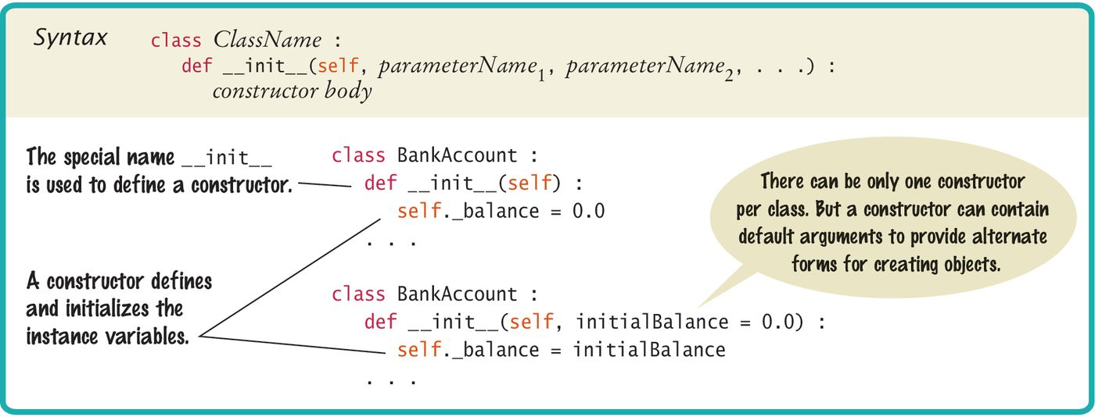
Syntax: Constructors

Slide 34
Constructors: Self
The first parameter variable of every constructor must be self
When the constructor is invoked to construct a new object, the self parameter variable is set to the object that is being initialized
Refers to the object being initialized
def _ _init_ _(self) :
self._itemCount = 0
self._totalPrice = 0
register = CashRegister()
After the constructor ends this is a reference to the newly created object

Slide 35
Object References
register = CashRegister()
After the constructor ends this is a reference to the newly created object
This reference then allows methods of the object to be invoked
print("Your total $", register.getTotal())
Call the method through the reference

Slide 36
Common Error 9.1 (1)
After an object has been constructed, you should not directly call the constructor on that object again:
register1 = CashRegister()
register1._ _init_ _() # Bad style

Slide 37
Common Error 9.1 (2)
The constructor can set a new CashRegister object to the cleared state, but you should not call the constructor on an existing object. Instead, replace the object with a new one:
register1 = CashRegister()
register1 = CashRegister() # OK
In general, you should never call a Python method that starts with a double underscore. The are intended for specific internal purposes (in this case, to initialize a newly created object).

Slide 38
Implementing Methods
Implementing a method is very similar to implementing a function except that you access the instance variables of the object in the method body
def addItem(self, price):
self._itemCount = self._itemCount + 1
self._totalPrice = self._totalPrice + price
Task | Method
Add the price of an item | addItem(price)
Get the total amount owed | getTotal()
Get the count of items purchased | getCount()
Clear the cash register for a new sale | clear()

Slide 39
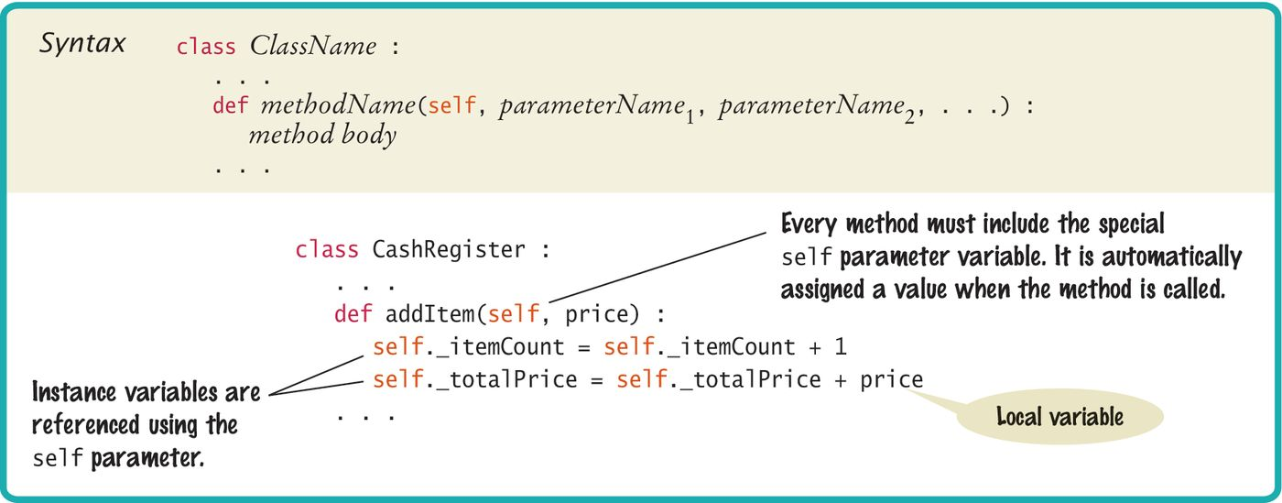
Syntax: Instance Methods
Use instance variables inside methods of the class
  Similar to the constructor, all other instance methods must include the self parameter as the first parameter
  You must specify the self implicit parameter when using instance variables inside the class

Slide 40
Invoking Instance Methods
As with the constructor, every method must include the special self parameter variable, and it must be listed first.
When a method is called, a reference to the object on which the method was invoked (register1) is automatically passed to the self parameter variable:
register1.addItem(2.95)
def addItem(self, price):

Slide 41
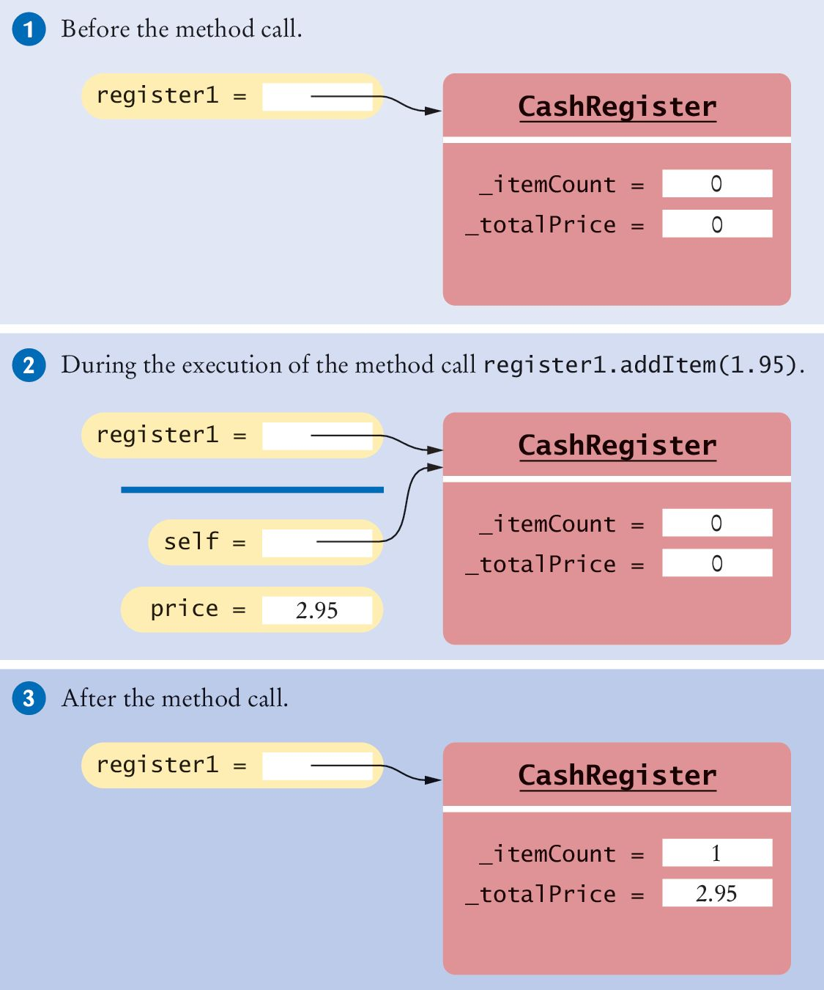
Tracing The Method Call
register1 = CashRegister() #1 New object
register1.addItem(2.95) #2 Calling method
… #3 After method
def addItem(self, price):
self._itemCount =
self._itemCount + 1
self._totalPrice =
self._totalPrice + price

Slide 42
Accessing Instance Variables
To access an instance variable, such as _itemCount or _totalPrice, in a method, you must access the variable name through the self reference
  This indicates that you want to access the instance variables of the object on which the method is invoked, and not those of some other CashRegister object
The first statement in the addItem() method is
  self._itemCount = self._itemCount + 1

Slide 43
Accessing Instance Variables
Which _itemCount is incremented?
  In this call, it is the _itemCount of the register1 object.

Slide 44
Calling One Method Within Another
When one method needs to call another method on the same object, you invoke the method on the self parameter
def addItems(self, quantity, price) :
for i in range(quantity) :
self.addItem(price)

Slide 45
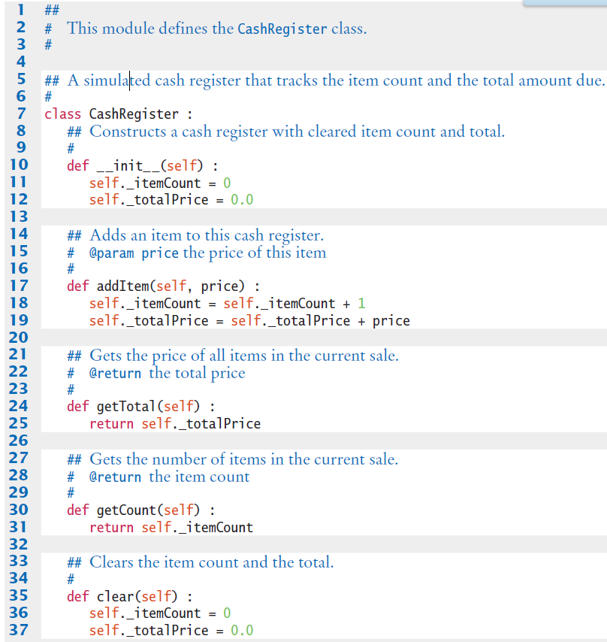
Example: CashRegister.py (1)

Slide 46

Programming Tip 9.2
Instance variables should only be defined in the constructor
All variables, including instance variables, are created at run time
  There is nothing to prevent you from creating instance variables in any method of a class
The constructor is invoked before any method can be called, so any instance variables that were created in the constructor are sure to be available in all methods

Slide 47
Class Variables
They are a value properly belongs to a class, not to any object of the class
Class variables are often called “static variables”
Class variables are declared at the same level as methods
  In contrast, instance variables are created in the constructor

Slide 48
Class Variables: Example (1)
We want to assign bank account numbers sequentially: the first account is assigned number 1001, the next with number 1002, and so on
To solve this problem, we need to have a single value of _lastAssignedNumber that is a property of the class, not any object of the class
class BankAccount :
_lastAssignedNumber = 1000 # A class variable
def _ _init_ _(self) :
self._balance = 0
BankAccount._lastAssignedNumber =
BankAccount._lastAssignedNumber + 1
self._accountNumber =
BankAccount._lastAssignedNumber

Slide 49
Class Variables: Example (2)
Every BankAccount object has its own _balance and _account-Number instance variables, but there is only a single copy of the _lastAssignedNumber variable
That variable is stored in a separate location, outside any BankAccount object
Like instance variables, class variables should always be private to ensure that methods of other classes do not change their values. However, class constants can be public

Slide 50
Class Variables: Example (3)
For example, the BankAccount class can define a public constant value, such as
class BankAccount :
OVERDRAFT_FEE = 29.95
. . .
Methods from any class can refer to such a constant as BankAccount.OVERDRAFT_FEE

Slide 51
Testing a Class
In the long run, your class may become a part of a larger program that interacts with users, stores data in files, and so on
You should always test your class in isolation integrating a class into a program
Testing in isolation, outside a complete program, is called unit testing

Slide 52
Choices for Testing: The Python shell
Some interactive development environments provide access to the Python shell in which individual statements can be executed
You can test a class simply by constructing an object, calling methods, and verifying that you get the expected return values
>>> from cashregister import CashRegister
>>> reg = CashRegister()
>>> reg.addItem(1.95)
>>> reg.addItem(0.95)
>>> reg.addItem(2.50)
>>> print(reg.getCount())
3
>>> print(reg.getTotal())
5.4
>>>

Slide 53
Choices for Testing: Test Drivers
Interactive testing is quick and convenient but it has a drawback
  When you find and fix a mistake, you need to type in the tests again
As your classes get more complex, you should write tester programs
  A tester program is a driver module that imports the class and contains statements to run methods of your class

Slide 54
Steps Performed by a Tester Program
Construct one or more objects of the class that is being tested
Invoke one or more methods
Print out one or more results
Print the expected results
Compare the computed results with the expected

Slide 55
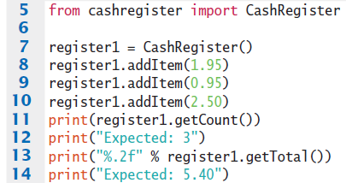

Example Test Program
It runs and tests the methods of the CashRegister class
Program execution

Slide 56
Test Drivers: Plan Beforehand
Thinking about the sample program:
  We add three items totaling $5.40
  When displaying the method results, we also display messages that describe the values we expect to see
This is a very important step. You want to spend some time thinking about what the expected result is before you run a test program
This thought process will help you understand how your program should behave, and it can help you track down errors at an early stage

Slide 57
Test Drivers: Using Modules
You need to import the class you are testing (here, the CashRegister class) into the driver module:
from cashregister import CashRegister
The specific details for running the program depend on your development environment

Slide 58
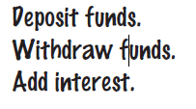

Steps to Implementing a Class
1) Get an informal list of responsibilities for your objects
  There is a hidden responsibility as well. We need to be able to find out how much money is in the account.

Slide 59
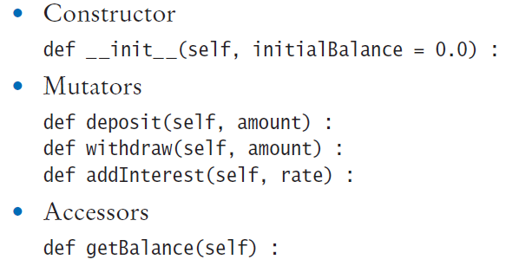

Steps to Implementing a Class
2) Specify the public interface
3) Document the public interface

Slide 60


Steps to Implementing a Class
4) Determine the instance variables
5) Implement constructors and methods
6) Test your class

Slide 61
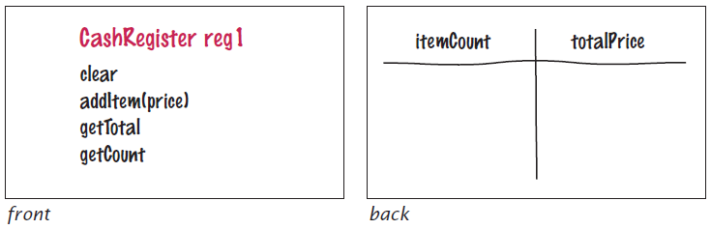
Problem Solving: Tracing Objects
Use an Index card for each object:
  An object is manipulated through the public interface (front of the card).
  The encapsulated data is on the back of the card

Slide 62
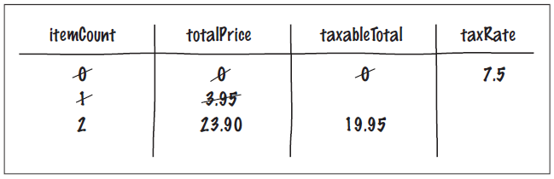
Mutator Methods and Cards
As mutator methods are called, keep track of the value of instance variables
register2 = CashRegister(7.5) # 7.5 percent sales tax
register2.addItem(3.95, False) # Not taxable
register2.addItem(19.95, True) # Taxable

Slide 63
Problem Solving: Patterns for Object Data
Common patterns when designing instance variables
  Keeping a Total
  Counting Events
  Collecting Values
  Managing Object Properties
  Modeling Objects with Distinct States
  Describing the Position of an Object

Slide 64
Patterns: Keeping a Total
Examples
  Bank account balance
  Cash Register total
  Car gas tank fuel level
Variables needed
  totalPrice
Methods Required
  add (addItem)
  clear
  getTotal
class CashRegister :
def addItem(self, price):
self._itemCount =
self._itemCount + 1
self._totalPrice =
self._totalPrice + price
def clear(self):
self._itemCount = 0
self._totalPrice = 0.0
def getTotal(self):
return self._totalPrice

Slide 65
Patterns: Counting Events
Examples
  Cash Register items
  Bank transaction fee
Variables needed
  itemCount
Methods Required
  Add
  Clear
  Optional: getCount
class CashRegister:
def addItem(self, price):
self._itemCount =
self._itemCount + 1
self._totalPrice =
self._totalPrice + price
def clear(self):
self._itemCount = 0
self._totalPrice = 0.0
def getCount(self):
return self._itemCount

Slide 66
Patterns: Collecting Values
Examples
  Multiple choice question
  Shopping cart
Storing values
  List
Constructor
  Initialize to empty collection
Methods Required
  Add
class Cart:
def _ _init_ _(self) :
self._choices = []
def addItem(self, name) :
self._choices.append
(choice)

Slide 67
Patterns: Managing Properties
A property of an object can be set and retrieved
Examples
  Student: name, ID
Constructor
  Set a unique value
Methods Required
  set
  get
class Student :
def _ _init_ _
(self, aName, anId) :
self._name = aName
self._id = anId
def getName(self) :
return self._name
def setName(self, newName) :
self._name = newName
def getId(self) :
return self._id
# No setId method

Slide 68
Patterns: Modeling Object States
Some objects can be in one of a set of distinct states
Example: A fish
  Hunger states:
    Not Hungry
    Somewhat Hungry
    Very Hungry
Methods will change the state
  eat
  move
class Fish:
NOT_HUNGRY = 0
SOMEWHAT_HUNGRY = 1
VERY_HUNGRY = 2
def eat(self) :
self._hungry =
Fish.NOT_HUNGRY
def move(self) :
if self._hungry <
Fish.VERY_HUNGRY :
self._hungry =
self._hungry + 1

Slide 69

Patterns: Object Position
Examples
  Game object
  Bug (on a grid)
  Cannonball
Storing values
  Row, column, direction, speed. . .
Methods Required
  move
  turn
class Bug:
def _ _init_ _
(self, aRow, aColumn,
aDirection, speed) :
self._row = aRow
self._column = aColumn
self._direction =
direction
# 0 = N, 1 = E, 2 = S, 3 = W
. . .
def moveOneUnit(self):
if (self._direction == 0):
self._row =
self._row - 1
. . .

Slide 70
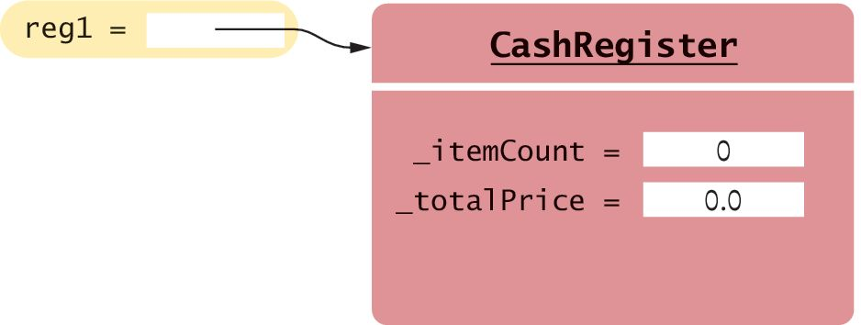
Object References
In Python, a variable does not actually hold an object
It merely holds the memory location of an object
The object itself is stored in another location:
reg1 = CashRegister
The constructor returns a reference to the new object, and that reference is stored in the reg1 variable.
Reference
Object

Slide 71
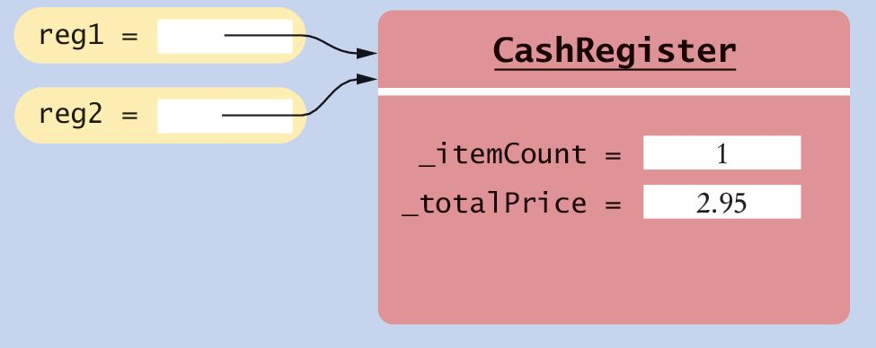
Shared References
Multiple object variables may contain references to the same object (‘aliases’)
  Single Reference
reg1 = CashRegister
  Shared References
reg2 = reg1
The internal values can be changed through either reference

Slide 72
Testing if References are Aliases
Checking if references are aliases, use the is or the not is operator:
if reg1 is reg2 :
print("The variables are aliases.")
if reg1 is not reg2 :
print("The variables refer to different objects.")
Checking if the data contained within objects are equal use the == operator:
if reg1 == reg2 :
print("The objects contain the same data.")

Slide 73
The None reference
A reference may point to ‘no’ object
  You cannot invoke methods of an object via a None reference – causes a run-time error
reg = None
print(reg.getTotal()) # Runtime Error!
  To test if a reference is None before using it:
middleInitial = None # No middle initial
if middleInitial is None :
print(firstName, lastName)
else :
print(firstName, middleInitial + ".", + lastName)

Slide 74
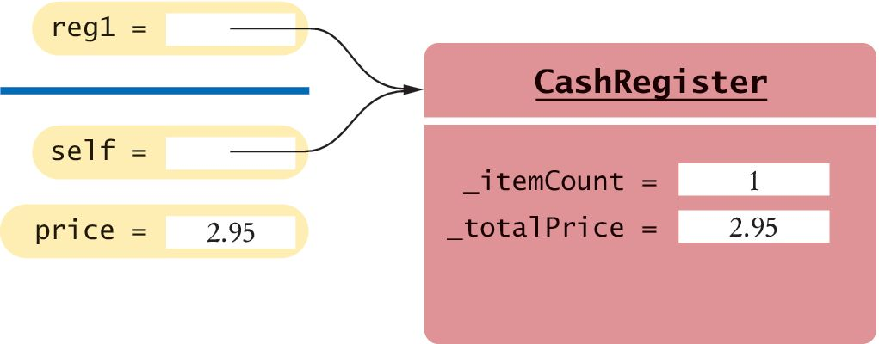
The self reference
Every method has a reference to the object on which the method was invoked, stored in the self parameter variable
  It is a reference to the object the method was invoked on:
  It can clarify when instance variables are used:
def addItem(self, price):
self.itemCount = self.itemCount + 1
self.totalPrice = self.totalPrice + price

Slide 75
Using self to Invoke Other Methods
You can also invoke a method on self:
def _ _init_ _(self) :
self.clear()
  In a constructor, self is a reference to the object that is being constructed
  The clear() method is invoked on that object

Slide 76
Passing self as a Parameter
Suppose, for example, you have a Person class with a method likes(self, other) that checks, perhaps from a social network, whether a person likes another
def isFriend(self, other) :
return self.likes(other) and other.likes(self)

Slide 77
Object Lifetimes: Creation
When you construct an object with a constructor, the object is created, and the self variable of the constructor is set to the memory location of the object
  Initially, the object contains no instance variables.
  As the constructor executes statements such as instance variables are added to the object
self._itemCount = 0
  Finally, when the constructor exits, it returns a reference to the object, which is usually captured in a variable:
reg1 = CashRegister()

Slide 78
Object Lifetimes: Cleaning Up
The object, and all of its instance variables, stays alive as long as there is at least one reference to it.
When an object is no longer referenced at all, it is eventually removed by a part of the virtual machine called the “garbage collector”
reg1 = CashRegister() # New object referenced by reg1
reg1 = CashRegister()
# Another object referenced by reg1
# First object will be garbage collected

Slide 79
Writing a Fraction Class
So far we have worked with floating-point numbers but computers store binary values, so not all real numbers can be represented precisely
In applications where the precision of real numbers is important, we can use rational numbers to store exact values
  This helps to reduce or eliminate round-off errors that can occur when performing arithmetic operations
  A rational number is a number that can be expressed as a ratio of two integers: 7/8
  The top value is called the numerator and the bottom value, which cannot be zero, is called the denominator

Slide 80
Designing the Fraction Class
We want to use our rational numbers as we would use integers and floating point values
Thus, our Fraction class must perform the following operations:
  Create a rational number
  Access the numerator and denominator values, individually
  Determine if the rational number is negative or zero
  Perform normal mathematical operations on two rational numbers (addition, subtraction, multiplication, division, exponentiation)
  Logically compare two rational numbers
  Produce a string representation of the rational number
The objects of the Fraction class will be immutable because none of the operations modify the objects’ instance variables

Slide 81
Required Data Attributes
Because a rational number consists of two integers, we need two instance variables to store those values:
self._numerator = 0
self._denominator = 1
At no time should the rational number be converted to a floating-point value or we will lose the precision gained from working with rational numbers

Slide 82
Representing Values Equivalently
Signed values
  Negative and positive rational numbers each have two forms that can be used to specify the corresponding value
  Positive values can be indicated as 1/2 or –1/–2, and negative values as –2/5 or 2/–5
  When performing an arithmetic operation or logically comparing two rational numbers, it will be much easier if we have a single way to represent a negative value
  For simplicity, we choose to set only the numerator to a negative value when the rational number is negative, and both the numerator and denominator will be positive integers when the rational number is positive

Slide 83
Representing Values Equivalently
Equivalent fractions
  For example, 1/4 can be written as 1/4, 2/8, 16/64, or 123/492
  It will be much easier to perform the operation if the number is stored in reduced form

Slide 84
The Constructor (1)
Because Fraction objects are immutable, their values must be set when they are created. This requires parameter variables for both the numerator and denominator
def _ _init_ _(self, numerator, denominator) :
The method must check for special cases:
  Zero denominators
  The number represents zero or a negative number

Slide 85
The Constructor
def _ _init_ _(self, numerator = 0, denominator = 1) :
if denominator == 0 :
raise ZeroDivisionError("Denominator cannot be zero.")
if numerator == 0 :
self._numerator = 0
self._denominator = 1
else :
if (numerator < 0 and denominator >= 0 or
numerator >= 0 and denominator < 0) :
sign = -1
else :
sign = 1

Slide 86
The Constructor
a = abs(numerator)
b = abs(denominator)
while a % b != 0 :
tempA = a
tempB = b
a = tempB
b = tempA % tempB
self._numerator = abs(numerator) # b * sign
self._denominator = abs(denominator) #b

Slide 87
Testing the Constructor
frac1 = Fraction(1, 8) # Stored as 1/8
frac2 = Fraction(-2, -4) # Stored as 1/2
frac3 = Fraction(-2, 4) # Stored as -1/2
frac4 = Fraction(3, -7) # Stored as -3/7
frac5 = Fraction(0, 15) # Stored as 0/1
frac6 = Fraction(8, 0) # Error! exception is raised.

Slide 88
Comparing Fractions (1)
In Python, we can define and implement methods that will be called automatically when a standard Python operator (+, *, ==, <) is applied to an instance of the class
For example, to test whether two fractions are equal, we could implement a method:
  isequal() and use it as follows:
if frac1.isequal(frac2) :
print("The fractions are equal.")

Slide 89
Comparing Fractions (2)
  Of course, we would prefer to use the operator ==
  This is achieved by defining the special method:
  _ _eq_ _():
def _ _eq_ _(self, rhsValue) :
return (self._numerator == rhsValue.numerator and
self._denominator == rhsValue.denominator)
  Automatically calls this method when we compare two Fraction objects using the == operator:
if frac1 == frac2 : # Calls frac1._ _eq_ _(frac2)
print("The fractions are equal.")

Slide 90
Special Methods
Some special methods are called when an instance of the class is passed to a built-in function. For example, suppose you attempt to convert a Fraction object to a floating point number using the float() function:
x = float(frac1)
Then the _ _float_ _() special method is called.
Here is a definition of that method:
def _ _float_ _(self) :
return self._numerator / self._denominator

Slide 91
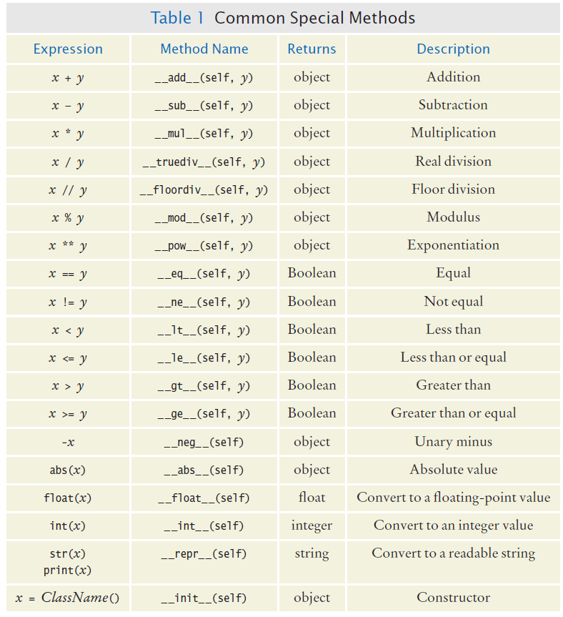
Common Special Methods

Slide 92
Common Special Methods

Slide 93
Addition of Fractions
All of the arithmetic operations that can be performed on a Fraction object should return the result in a new Fraction object
For example, when the statement below is executed, frac1 should be added to frac2 and the result returned as a new Fraction object that is assigned to the newFrac variable
newFrac = frac1 + frac2

Slide 94
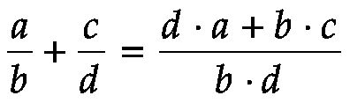
Fractional Addition
From elementary arithmetic, you know that two fractions must have a common denominator in order to add them. If they do not have a common denominator, we can still add them using the formula:

Slide 95
Defining the Method For Addition
def _ _add_ _(self, rhsValue) :
num = (self._numerator * rhsValue._denominator +
self._denominator * rhsValue._numerator)
den = self._denominator * rhsValue._denominator
return Fraction(num, den)

Slide 96
Logic: Less Than
Note that a / b < c / d when d · a < b · c. (Multiply both sides with b · d.)
Based on this observation, the less than operation is implemented by the _ _lt_ _() method as follows:
def _ _lt_ _(self, rhsValue) :
return (self._numerator * rhsValue._denominator
self._denominator * rhsValue._numerator)

Slide 97
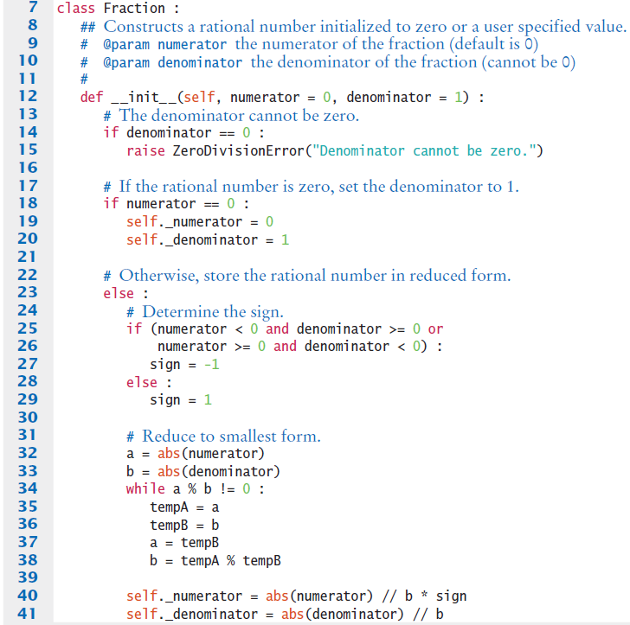
Fraction.py

Slide 98
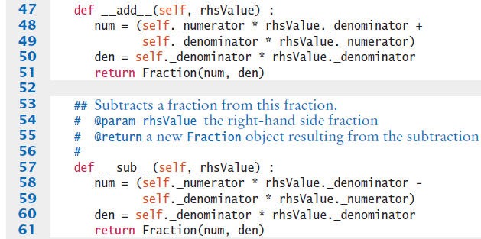

Fraction.py

Slide 99
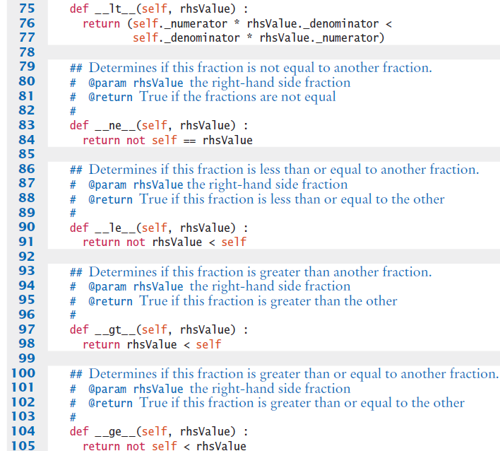
Fraction.py

Slide 100
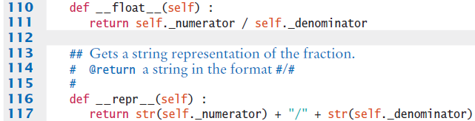
Fraction.py

Slide 101
Checking Type
To ensure that, Python provides the built-in isinstance() function that can be used to check the type of object referenced by a variable.
For example, the constructor for the Fraction class requires two integers
class Fraction :
def _ _init_ _(self, numerator, denominator) :
if (not isinstance(numerator, int) or
not isinstance(denominator, int)) :
raise TypeError
("The numerator and denominator must be integers.")

Slide 102
Summary: Classes and Objects
A class describes a set of objects with the same behavior
  Every class has a public interface: a collection of methods through which the objects of the class can be manipulated
  Encapsulation is the act of providing a public interface and hiding the implementation details
  Encapsulation enables changes in the implementation without affecting users of a class

Slide 103
Summary: Variables and Methods
An object’s instance variables store the data required for executing its methods
Each object of a class has its own set of instance variables
An instance method can access the instance variables of the object on which it acts
A private instance variable should only be accessed by the methods of its own class
Class variables have a single copy of the variable shared among all of the instances of the class

Slide 104
Summary: Method Headers, Data
Method Headers
  You can use method headers and method comments to specify the public interface of a class
  A mutator method changes the object on which it operates
  An accessor method does not change the object on which it operates
Data Representation
  For each accessor method, an object must either store or compute the result
  Commonly, there is more than one way of representing the data of an object, and you must make a choice
  Be sure that your data representation supports method calls in any order

Slide 105
Summary: Constructors
A constructor initializes the object’s instance variables
A constructor is invoked when an object is created
The constructor is defined using the special method name: _ _init_ _()
Default arguments can be used with a constructor to provide different ways of creating an object

Slide 106
Summary: Method Implementation
The object on which a method is applied is automatically passed to the self parameter variable of the method
In a method, you access instance variables through the self parameter variable

Slide 107
Summary: Testing Classes
A unit test verifies that a class works correctly in isolation, outside a complete program
To test a class, use an environment for interactive testing, or write a tester class to execute test instructions
Determining the expected result in advance is an important part of testing

Slide 108
Summary: Object Tracing
Object tracing is used to visualize object behavior
Write the methods on the front of a card, and the instance variables on the back
Update the values of the instance variables when a mutator method is called

Slide 109
Summary: Patterns for Classes
An instance variable for the total is updated in methods that increase or decrease the total amount
A counter that counts events is incremented in methods that correspond to the events
An object can collect other objects in a list
An object property can be accessed with a getter method and changed with a setter method
If your object can have one of several states that affect the behavior, supply an instance variable for the current state

Slide 110
Summary: Patterns for Classes
To model a moving object, you need to store and update its position

Slide 111
Summary: Object References
An object reference specifies the location of an object
Multiple object variables can contain references to the same object
Use the is and is not operators to test whether two variables are aliases
The None reference refers to no object

Slide 112
Summary: Defining Special Methods
To use a standard operator with objects, define the corresponding special method
Define the special _ _repr_ _() method to create a string representation of an object

